Slide 1
Data Science with Python
muksurat choudhury

Slide 2
Supervised Machine Learning
Select a dataset of your choice and create a supervised machine learning algorithm to provide further insight into the data.
Start with some exploration of the data – what are the fields, how are they distributed, will they require any transformations?
Prepare the dataset for machine learning
Create a supervised machine learning model
Measure the accuracy of your model
Try using two different supervised learning algorithms and use methods to measure their accuracy. Which model would you choose? Why?
Dataset 1 – Fraud Detection
Dataset 2 – Poisonous Mushrooms
Dataset 3 – Fake News

Slide 3
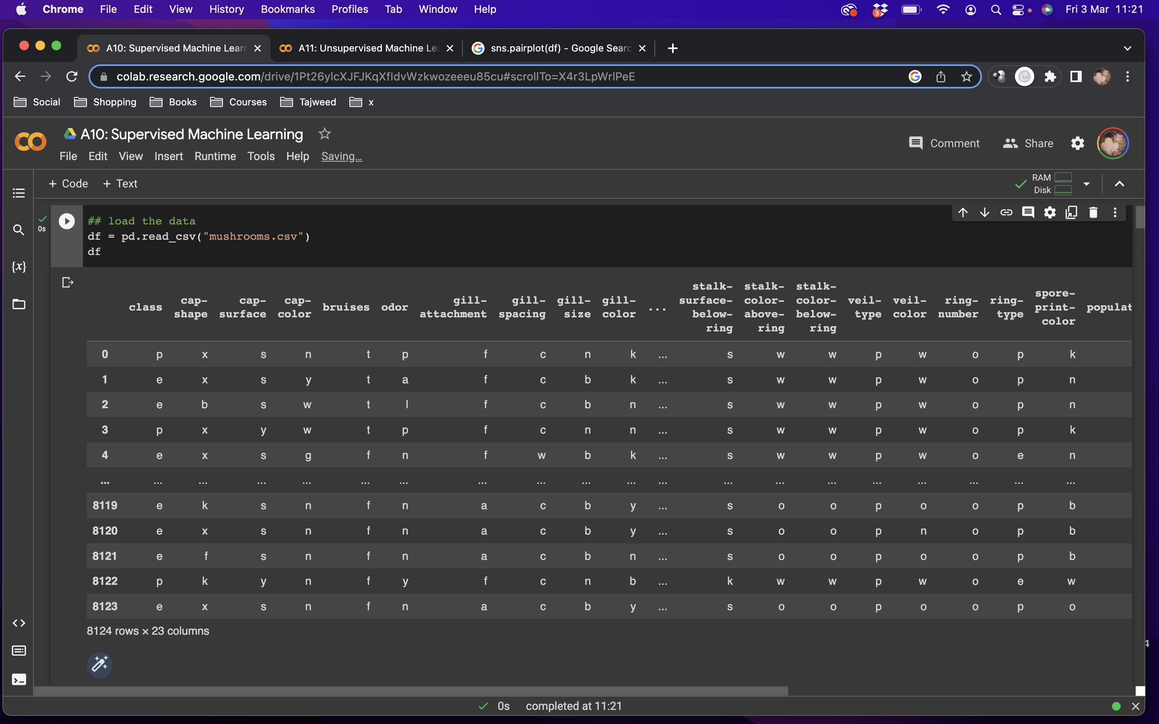
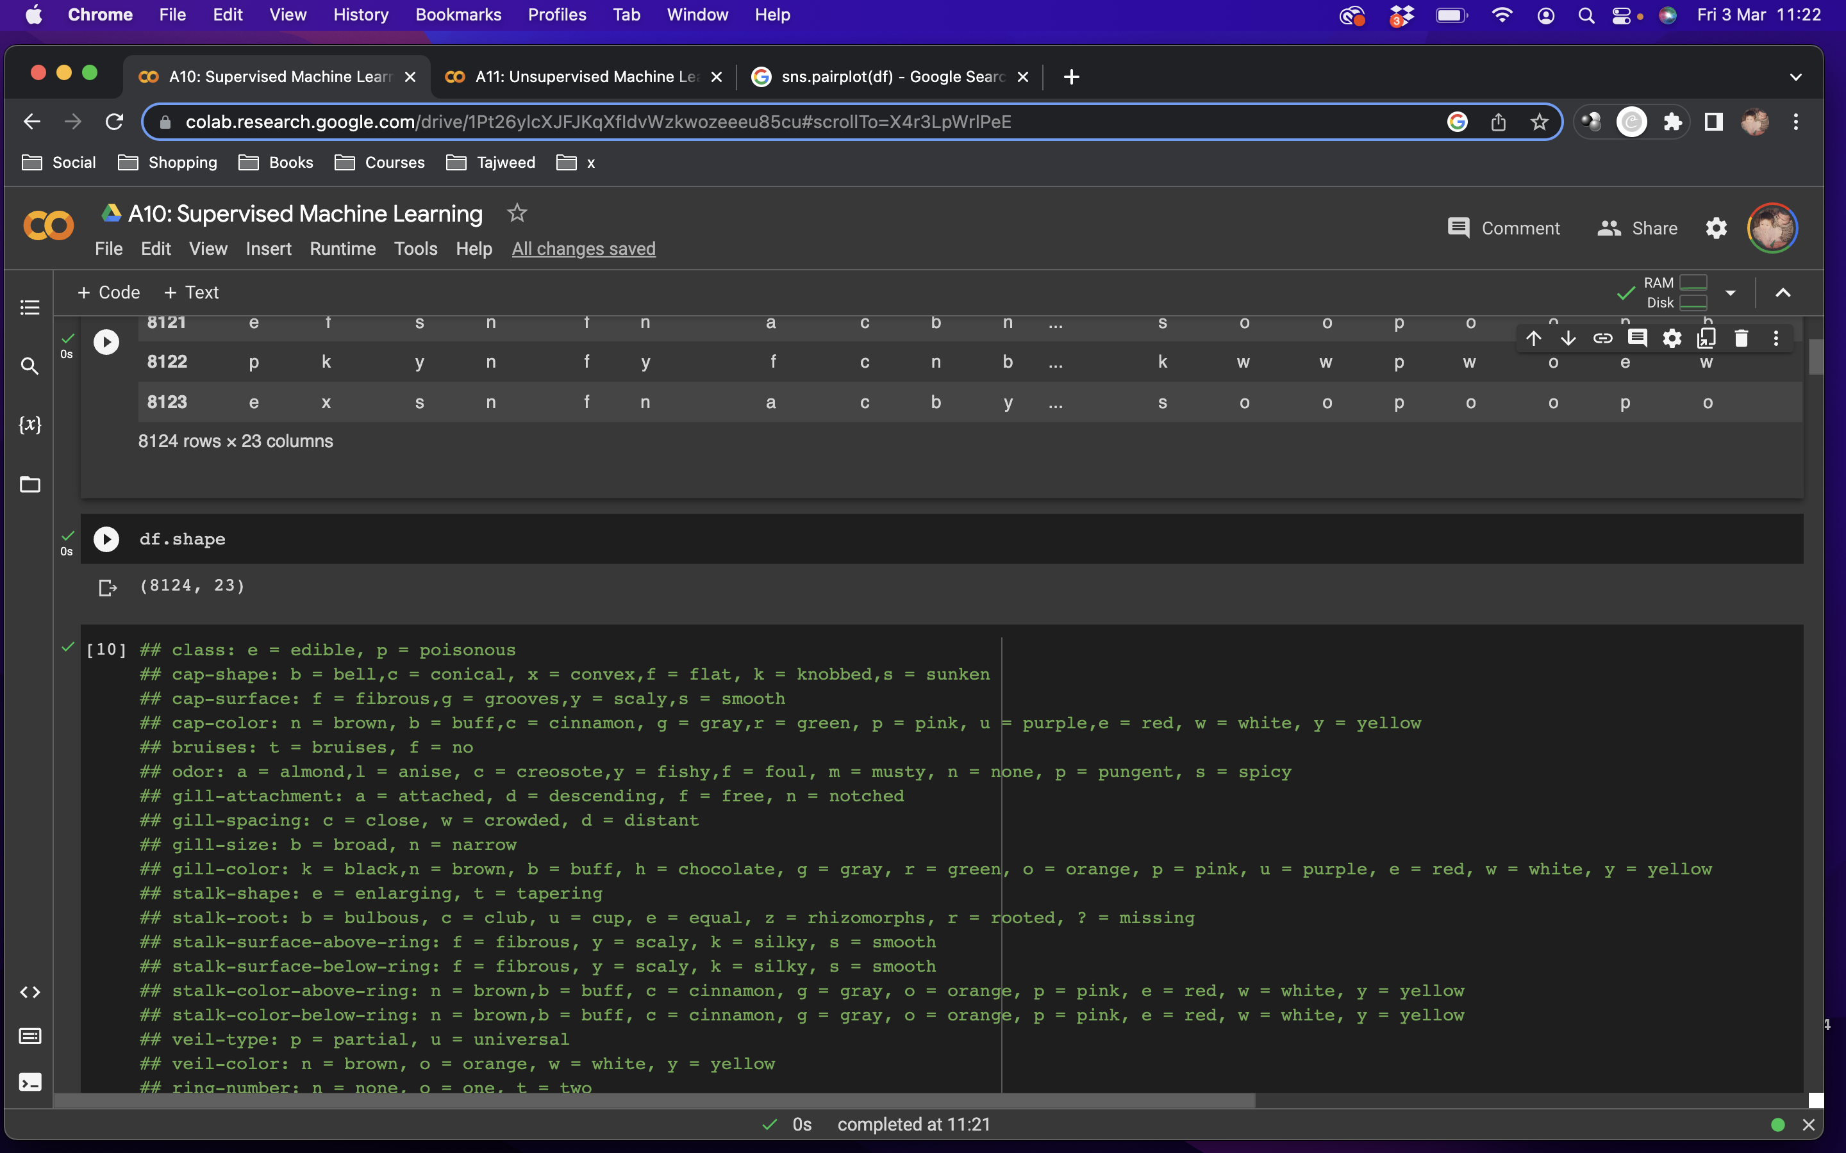
The Data: Poisonous Mushrooms
Notes:
First I loaded the data and had a quick look at it, there are over 8000 entries and 23 features
The dataset is not numerical, all the entries are single letters

Slide 4
The Data: Poisonous Mushrooms
class: e = edible, p = poisonous
cap-shape: b = bell, c = conical, x = convex, f = flat, k = knobbed, s = sunken
cap-surface: f = fibrous, g = grooves, y = scaly,s = smooth
cap-color: n = brown, b = buff, c = cinnamon, g = gray, r = green, p = pink, u = purple, e = red, w = white, y = yellow
bruises: t = bruises, f = no
odor: a = almond, l = anise, c = creosote, y = fishy, f = foul, m = musty, n = none, p = pungent, s = spicy
gill-attachment: a = attached, d = descending, f = free, n = notched
gill-spacing: c = close, w = crowded, d = distant
gill-size: b = broad, n = narrow
gill-color: k = black, n = brown, b = buff, h = chocolate, g = gray, r = green, o = orange, p = pink, u = purple, e = red, w = white, y = yellow
stalk-shape: e = enlarging, t = tapering
stalk-root: b = bulbous, c = club, u = cup, e = equal, z = rhizomorphs, r = rooted, ? = missing
stalk-surface-above-ring: f = fibrous, y = scaly, k = silky, s = smooth
stalk-surface-below-ring: f = fibrous, y = scaly, k = silky, s = smooth
stalk-color-above-ring: n = brown, b = buff, c = cinnamon, g = gray, o = orange, p = pink, e = red, w = white, y = yellow
stalk-color-below-ring: n = brown, b = buff, c = cinnamon, g = gray, o = orange, p = pink, e = red, w = white, y = yellow
veil-type: p = partial, u = universal
veil-color: n = brown, o = orange, w = white, y = yellow
ring-number: n = none, o = one, t = two
ring-type: c = cobwebby, e = evanescent, f = flaring, l = large, n = none, p = pendant, s = sheathing, z = zone
spore-print-color: k = black, n = brown, b = buff, h = chocolate, r = green, o = orange, u = purple, w = white, y = yellow
population: a = abundant, c = clustered, n = numerous, s = scattered, v = several, y = solitary
habitat: g = grasses, l = leaves, m = meadows, p = paths, u = urban, w = waste, d = woods
Notes:
So I had a look at what the letters meant under each feature
I’ve gone ahead and highlighted the ones that I later found are more significant features in predicting whether the mushrooms are poisonous or not
The most important feature is of course the class, e means the mushroom is edible and p means it is poisonous

Slide 5
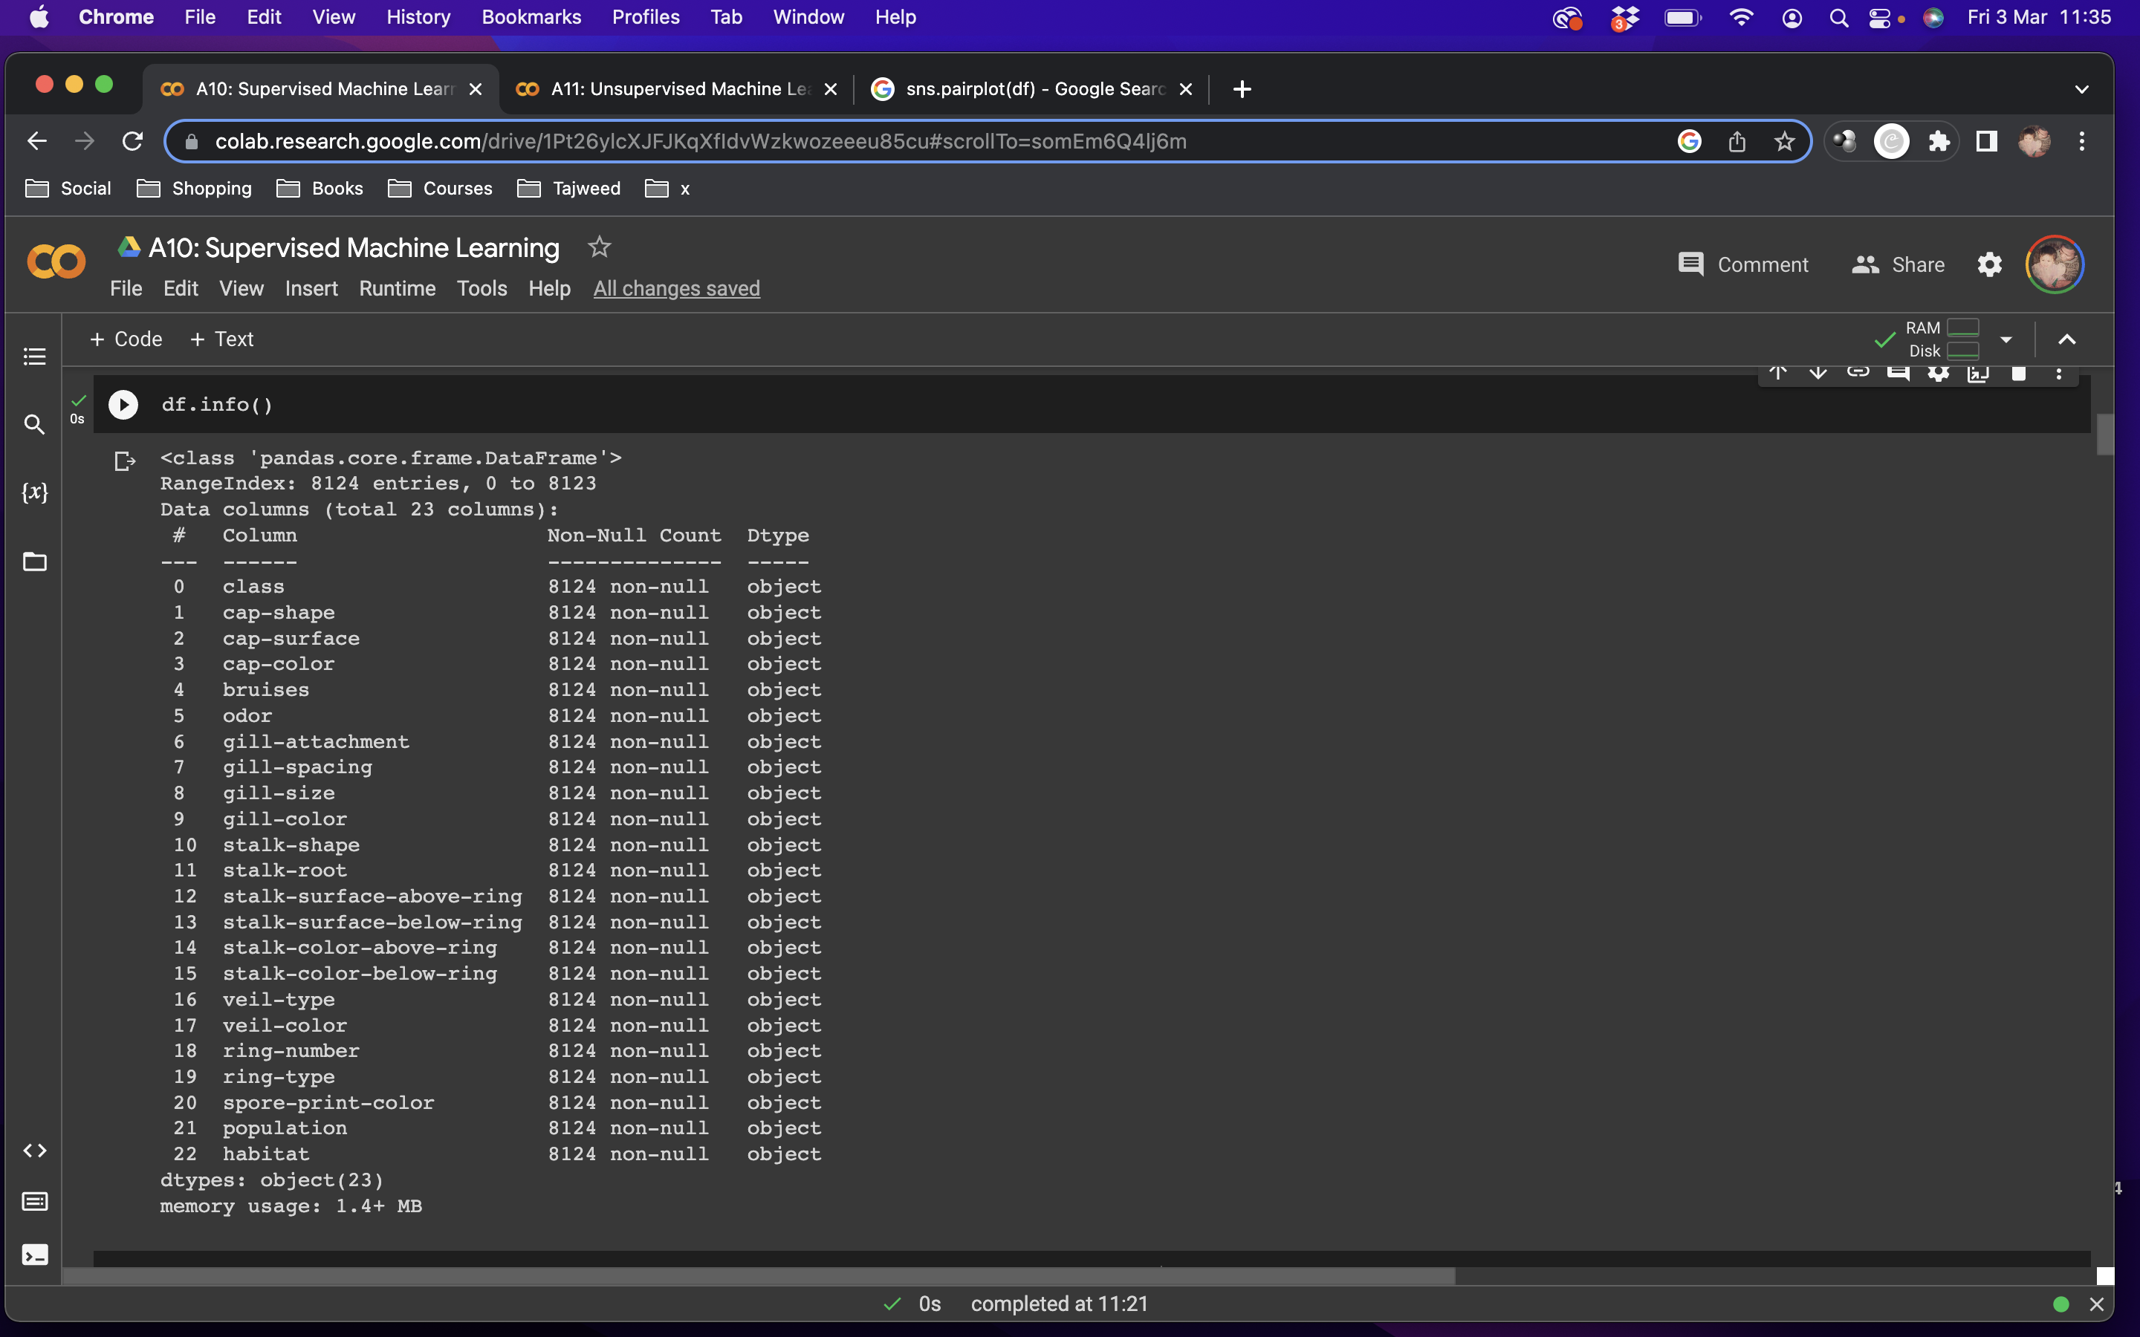
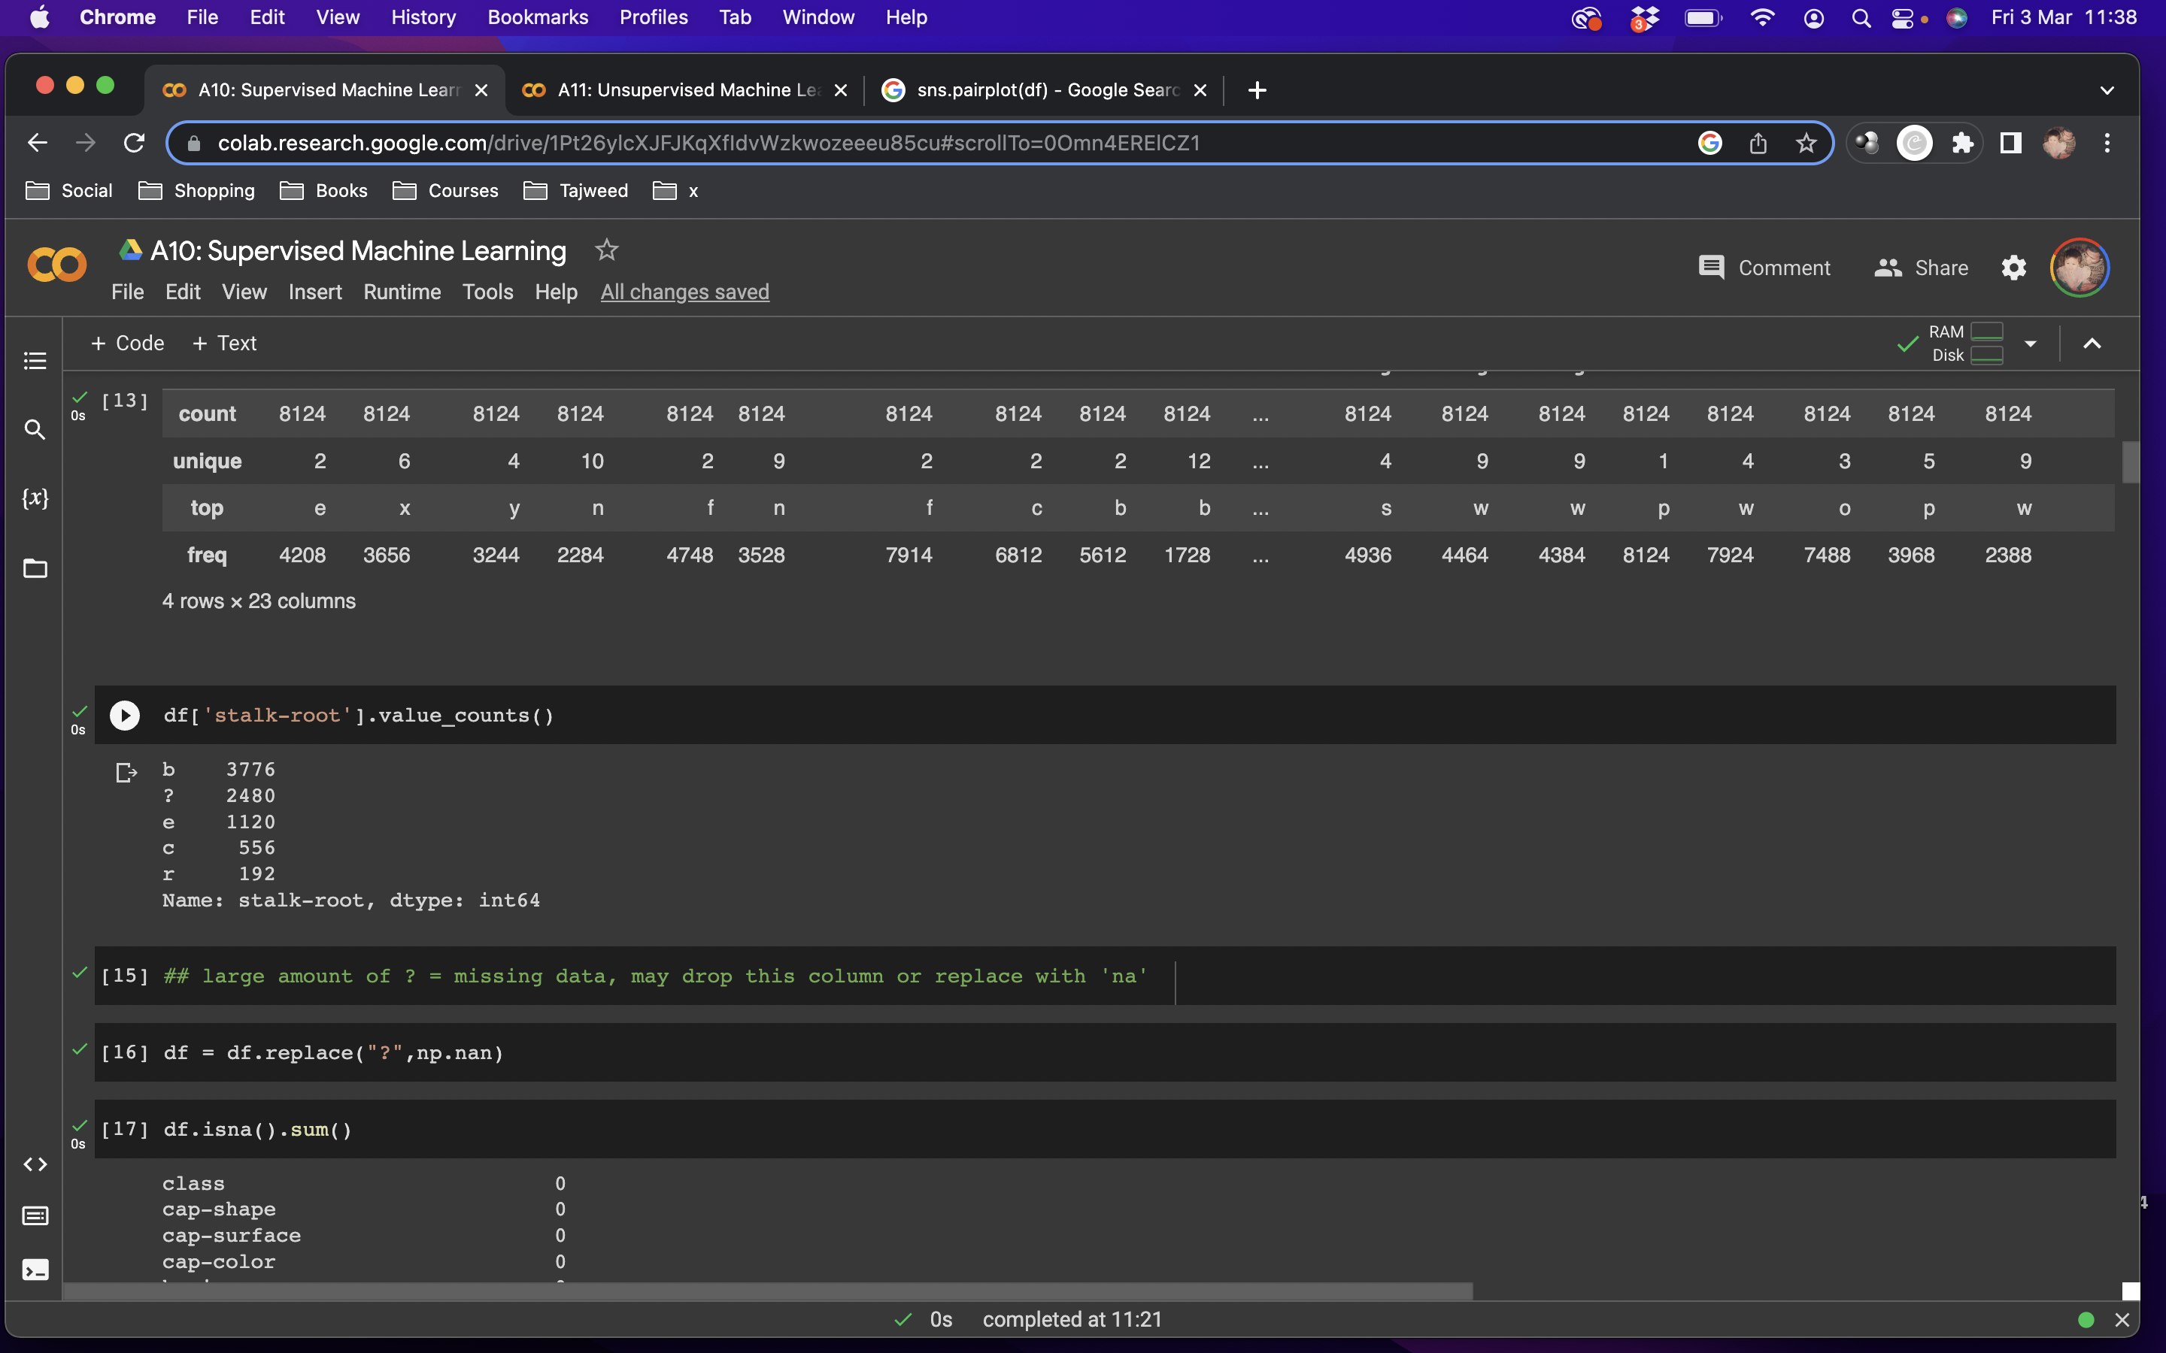
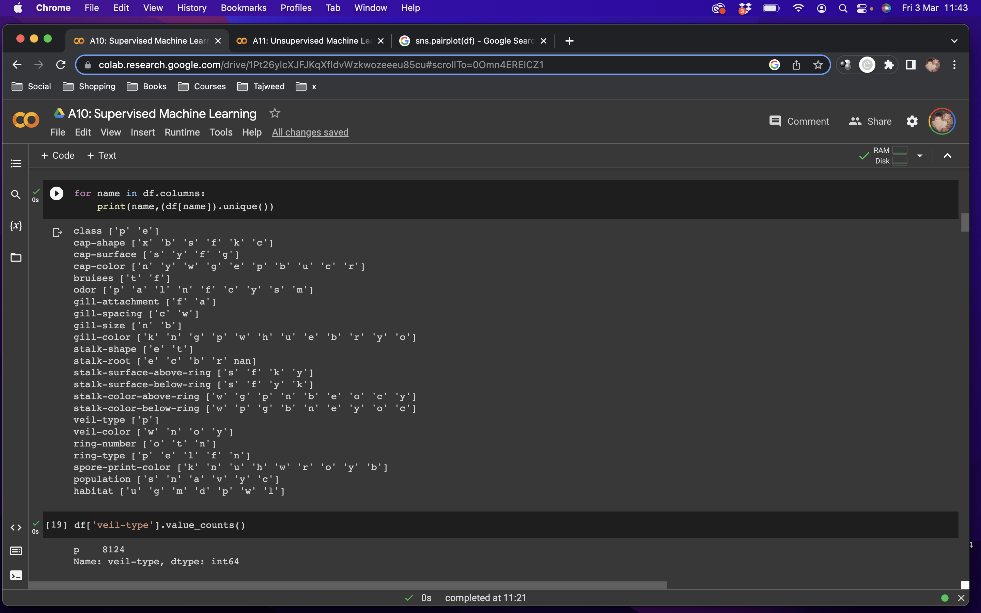
The Data: Poisonous Mushrooms
Notes:
On the left, I checked for null data and there is none, but from having a quick look at the spreadsheet, I know that ? is entered as missing data for stalk-root column
So I had a closer look at how many entries there were with ? and found over 2000 entries
We can either drop this column or replace it with na, I chose to replace it with na to represent unknown/unidentified types of stalk-root
On the right, I looked at how many unique entries there were in each feature, veil type only had one same entry for all the mushrooms so I dropped this column as it won’t help to identify if mushrooms are poisonous or not

Slide 6
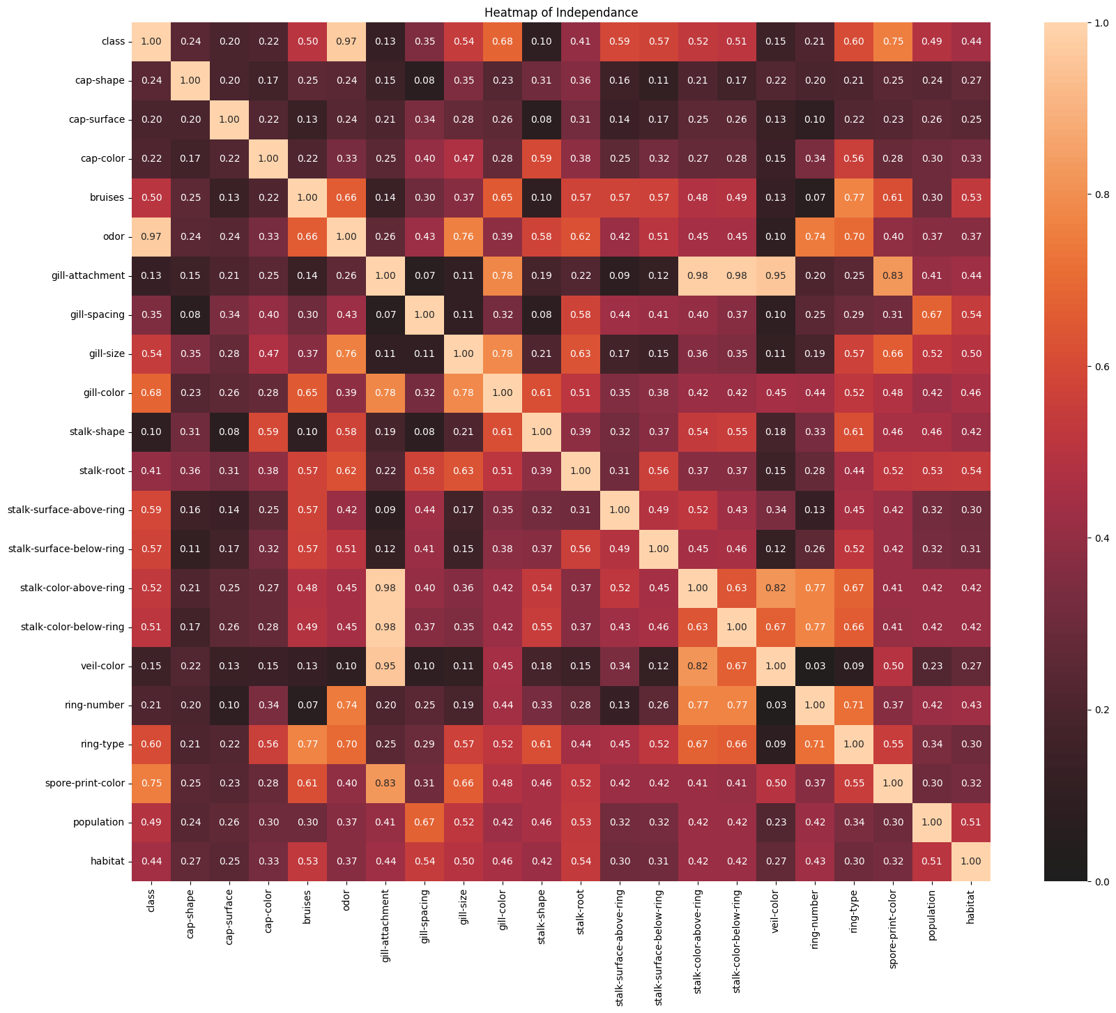
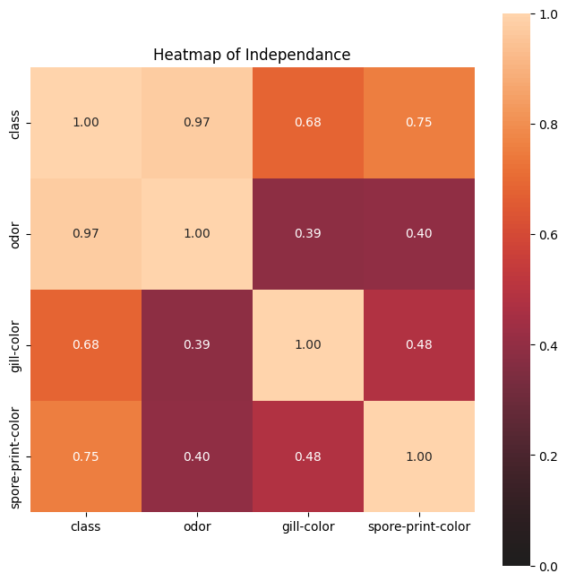
Data Analysis
Notes:
This heatmap of independence shows the associations between all the features
Its very large, so I had a closer look and made another heatmap of the more significant features against class that you can see on the right hand side
There is 97% correlation between odor and mushroom class
Spore print color and gill color are also highly correlated to mushroom class at 75% and 68%
Using this, I can see these features are the best predictors for the mushroom class to tell if the mushroom is poisonous or edible

Slide 7
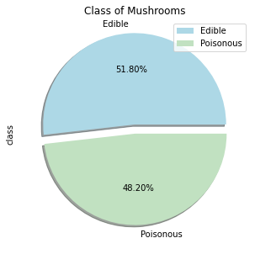
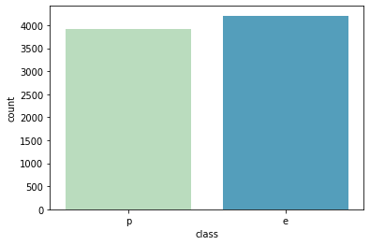
Notes:
Here we can see a total of 48% of mushrooms are poisonous in this dataset while just over half are actually edible

Slide 8
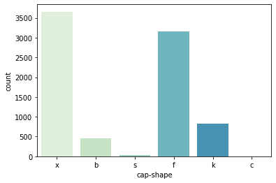
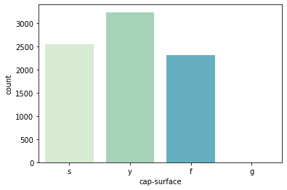
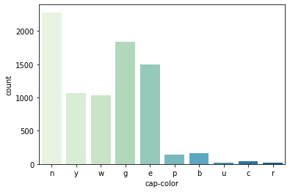
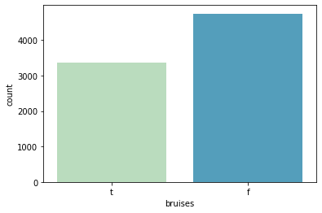
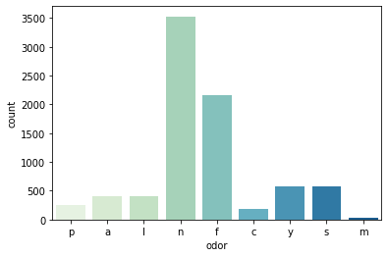
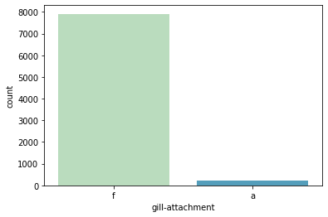
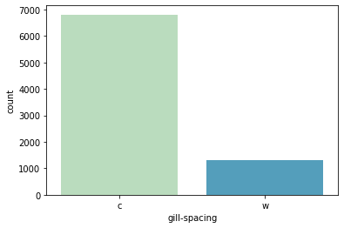
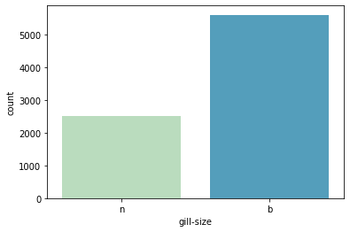
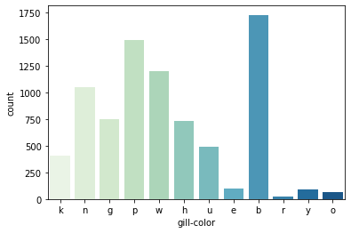
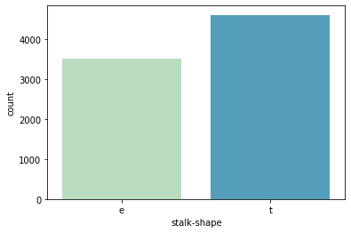
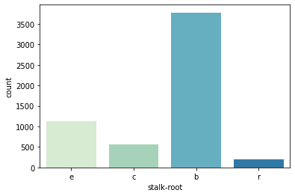
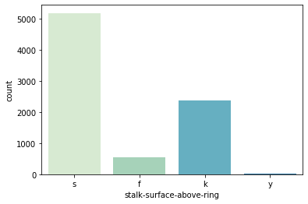
Notes:
These are some charts I made just to have a look at each individual feature in the dataset

Slide 9
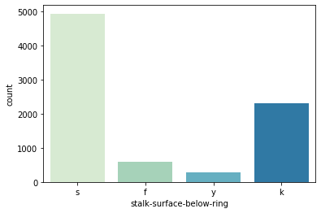
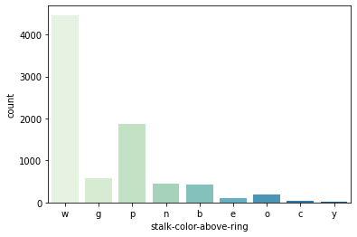
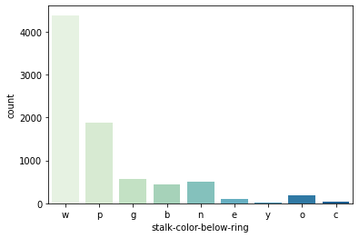
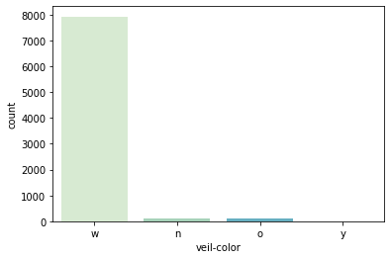
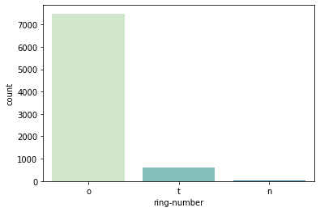
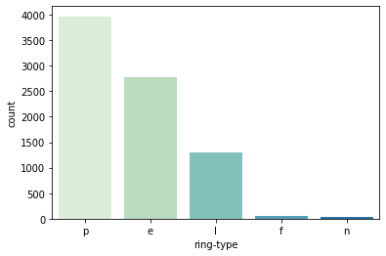
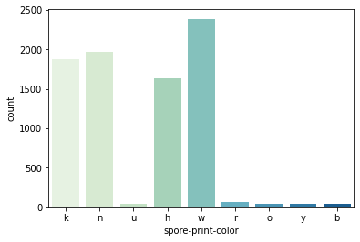
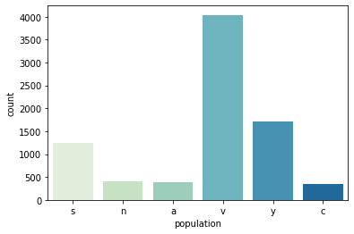
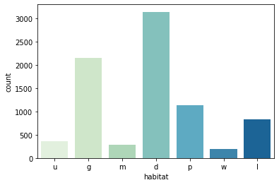

Slide 10
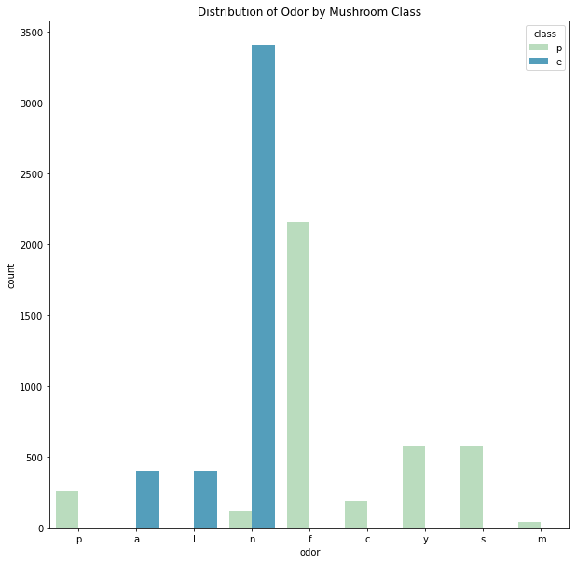
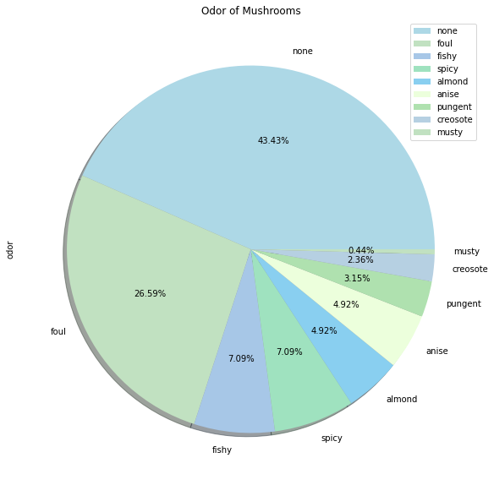
Notes:
I had a look at the odor of mushrooms, we can see the larger portions of oders either have no odor or foul odor
Foul, fishy and spicy odors make up a large percentage here
I also looked at the distribution of odor with mushroom class where most edible mushrooms have no smell
And most poisonous mushrooms have fould odor, followed by spicy and fishy

Slide 11
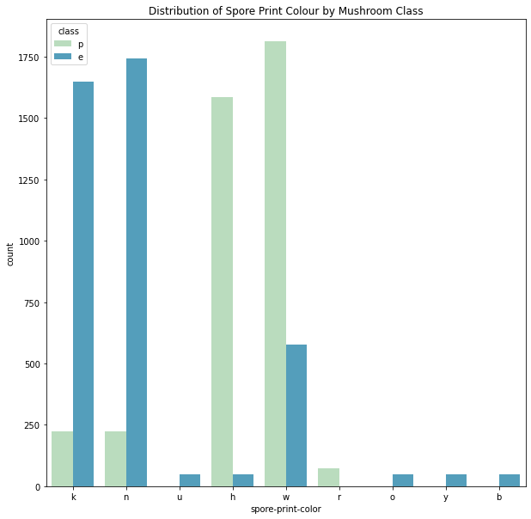
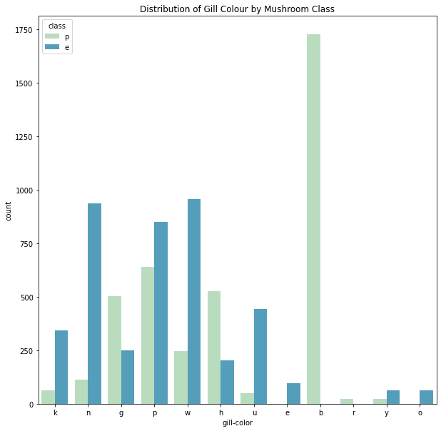
Notes:
These are just some more graphs to see the spore print color against class and gill colour against class too
Where the spore print color is usually w for white when poisonous and gill color is commonly b for buff when poisonous

Slide 12
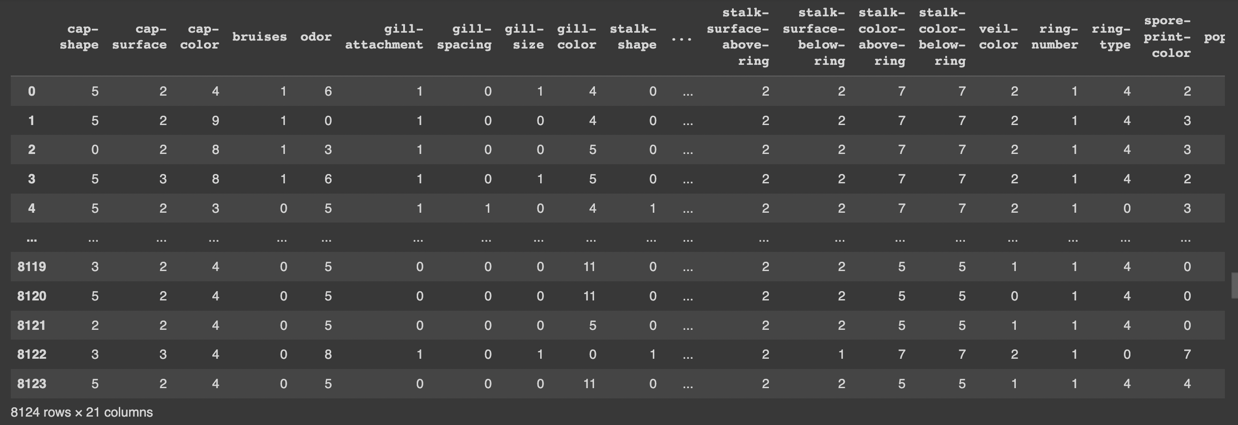
Training the Model
Notes:
I converted the data to numerical arrays and defined my x variables as all the features except class and y variable as mushroom class
Then I trained the model with 70% training and 30% testing

Slide 13
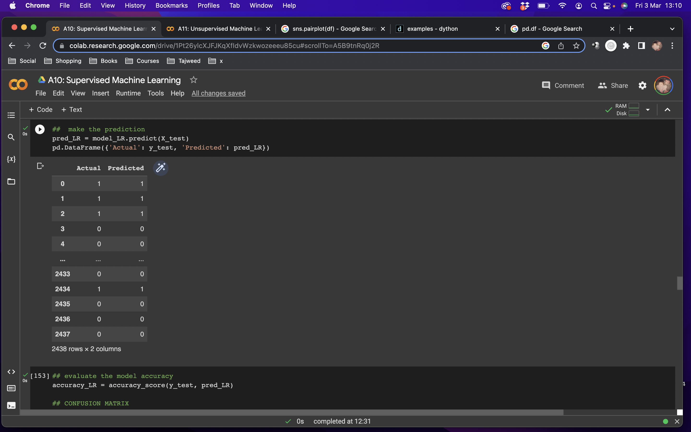
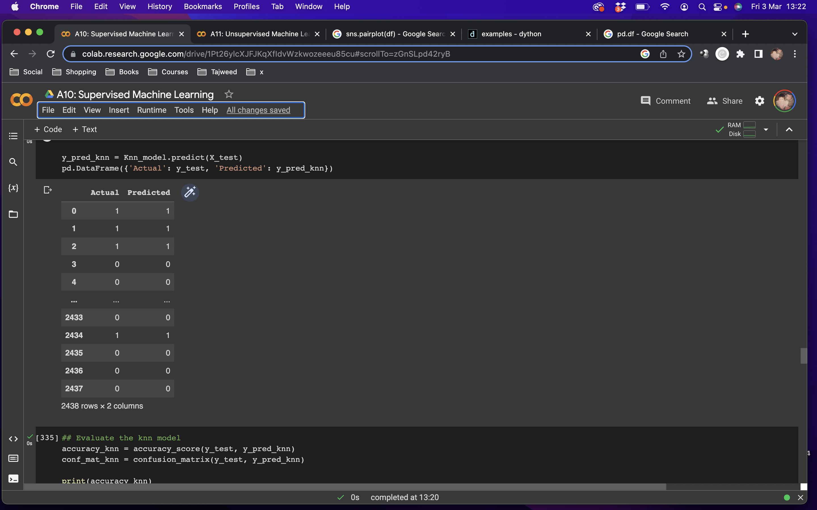
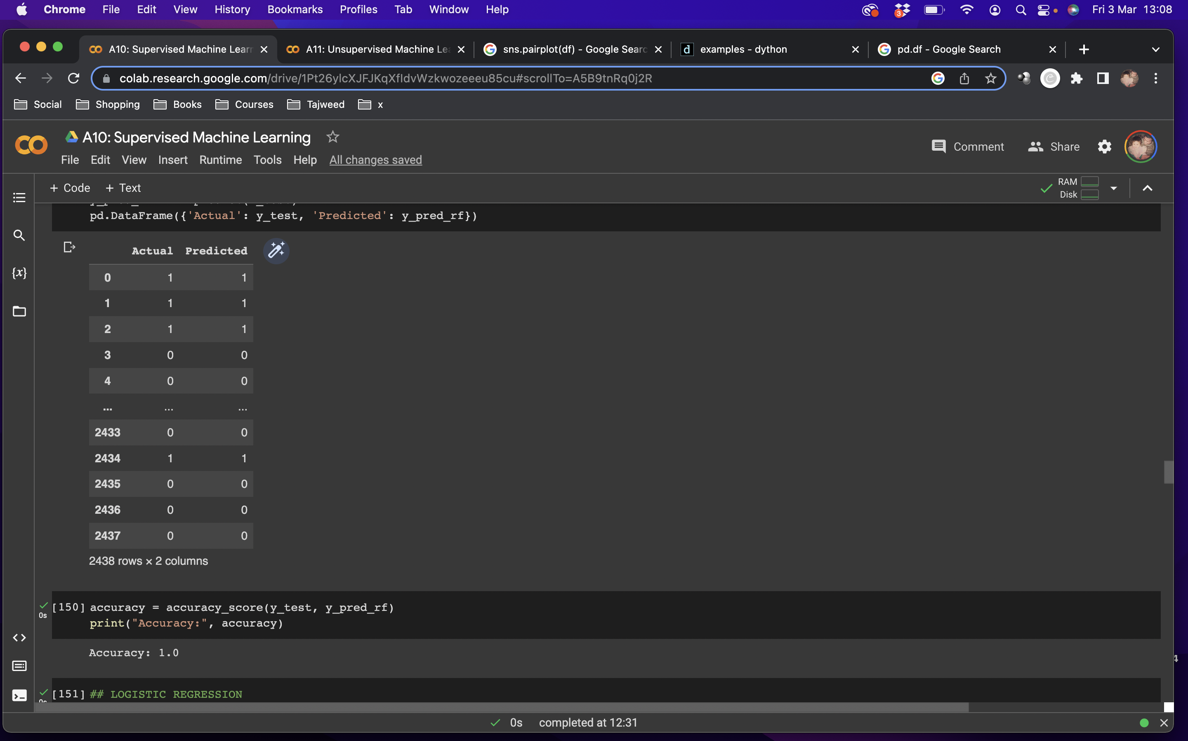
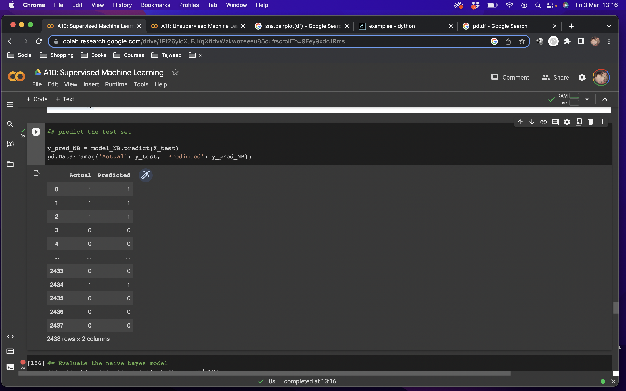
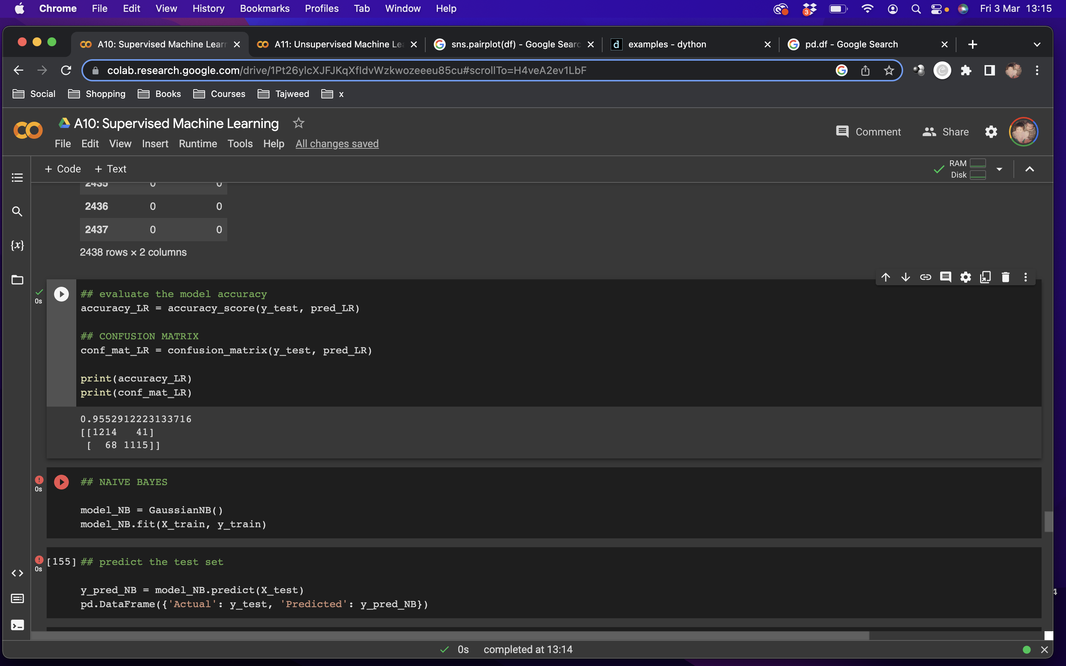
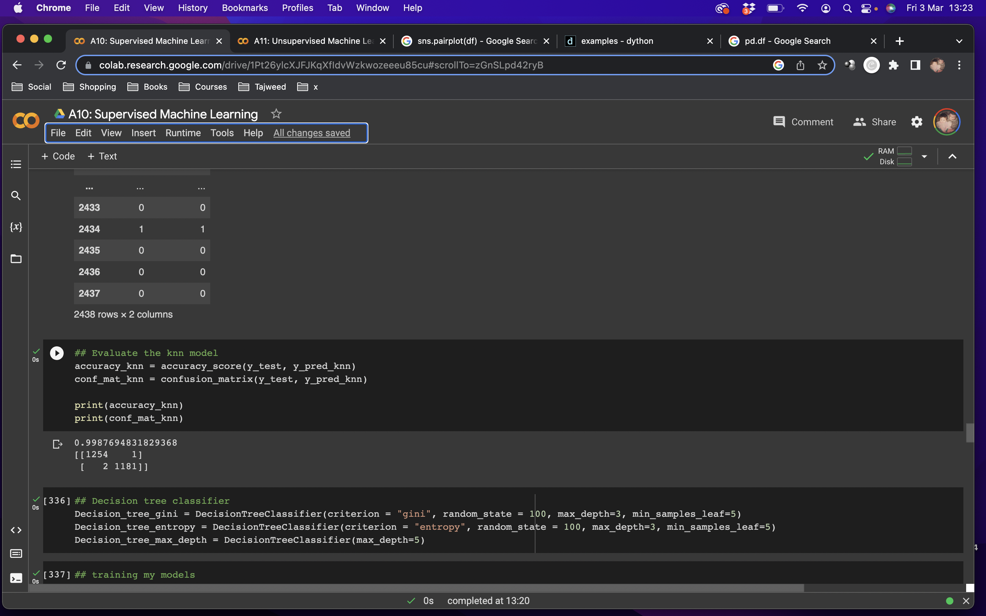
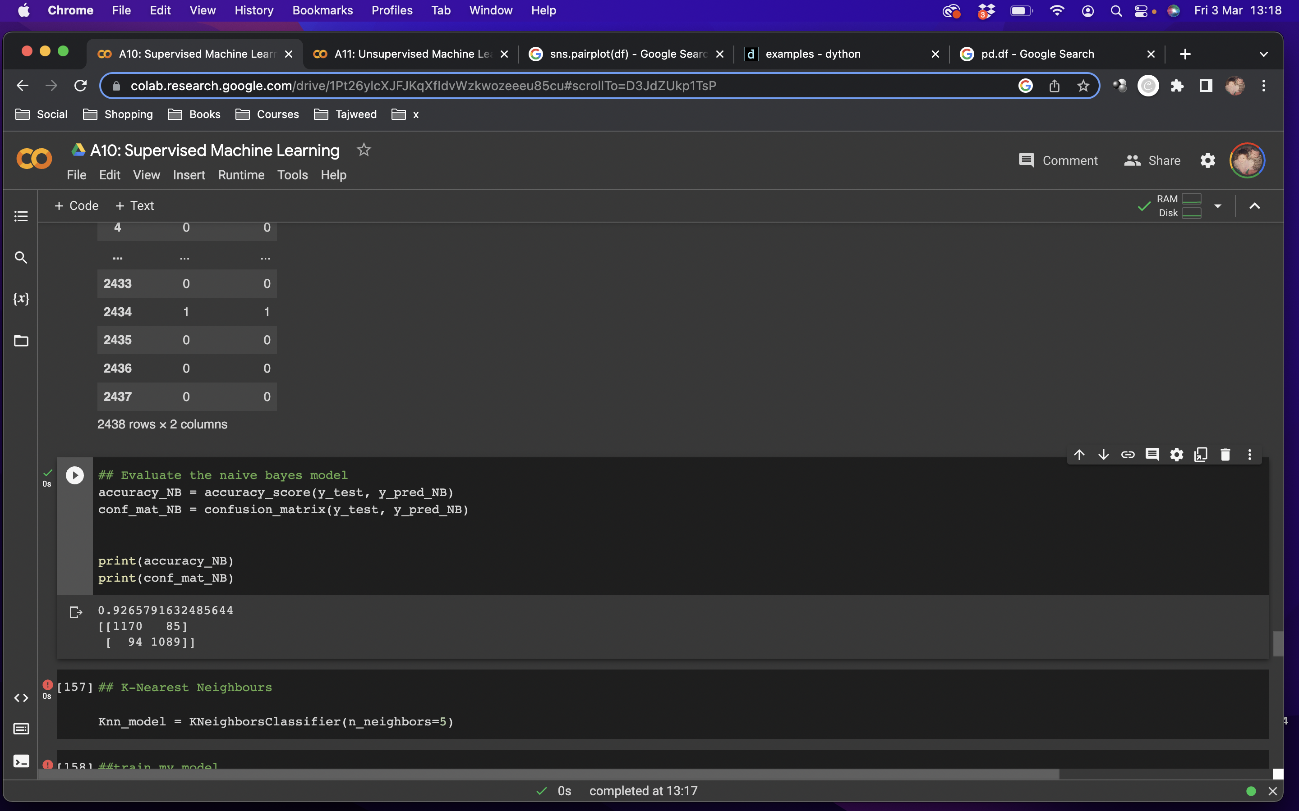

Random Forest Classifier
Logistic Regression
KNN
Naïve-Bayes
Notes:
I first tried random forest and I got an accuracy of 100%, this a perfect score, but honestly I thought maybe I made a mistake somewhere, maybe there is overfitting, so I did some other models to see the difference and I found that KNN was 99.8% accurate, logistic regression was 95.5% and naïve bayes was the lowest at 92.6%

Slide 14
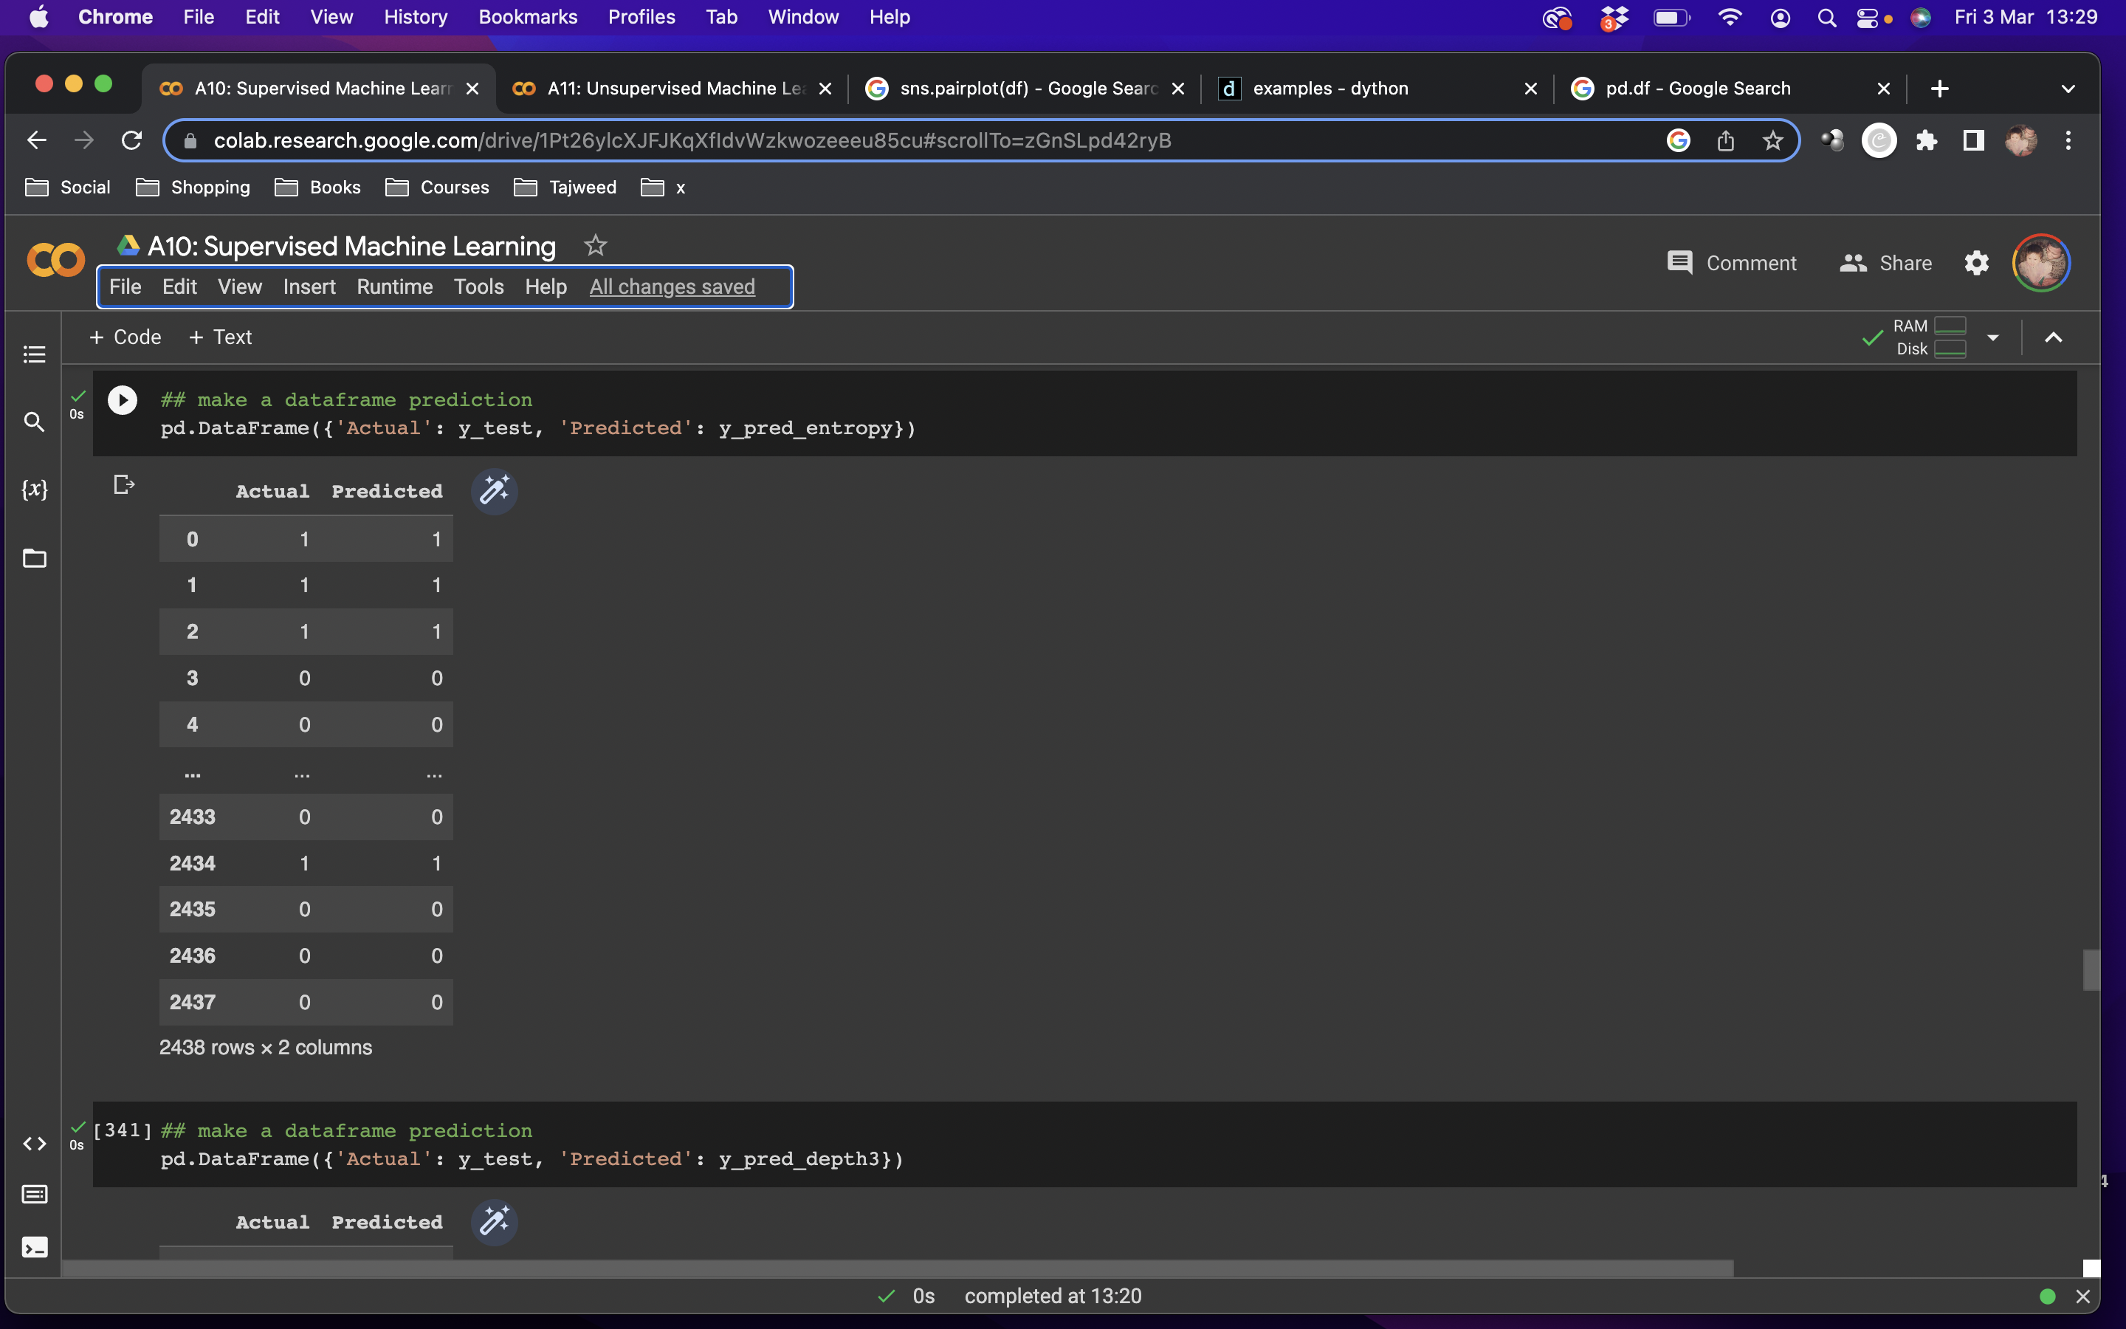
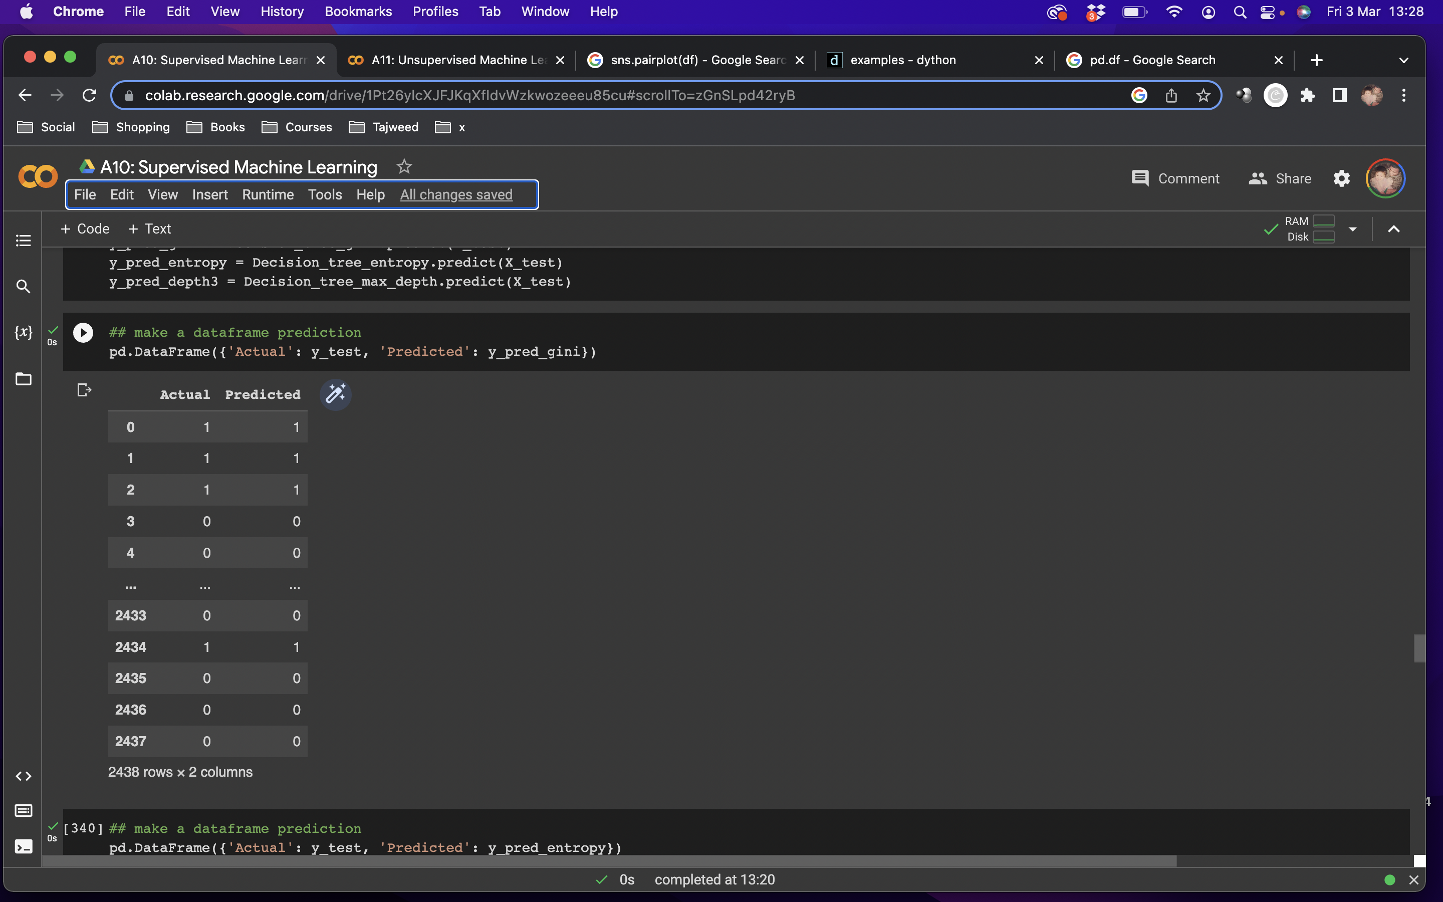
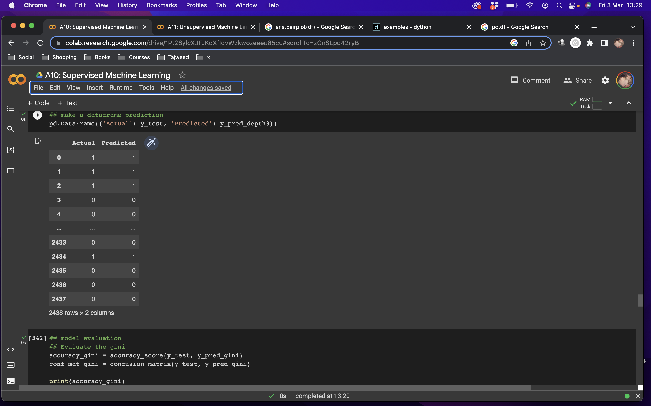
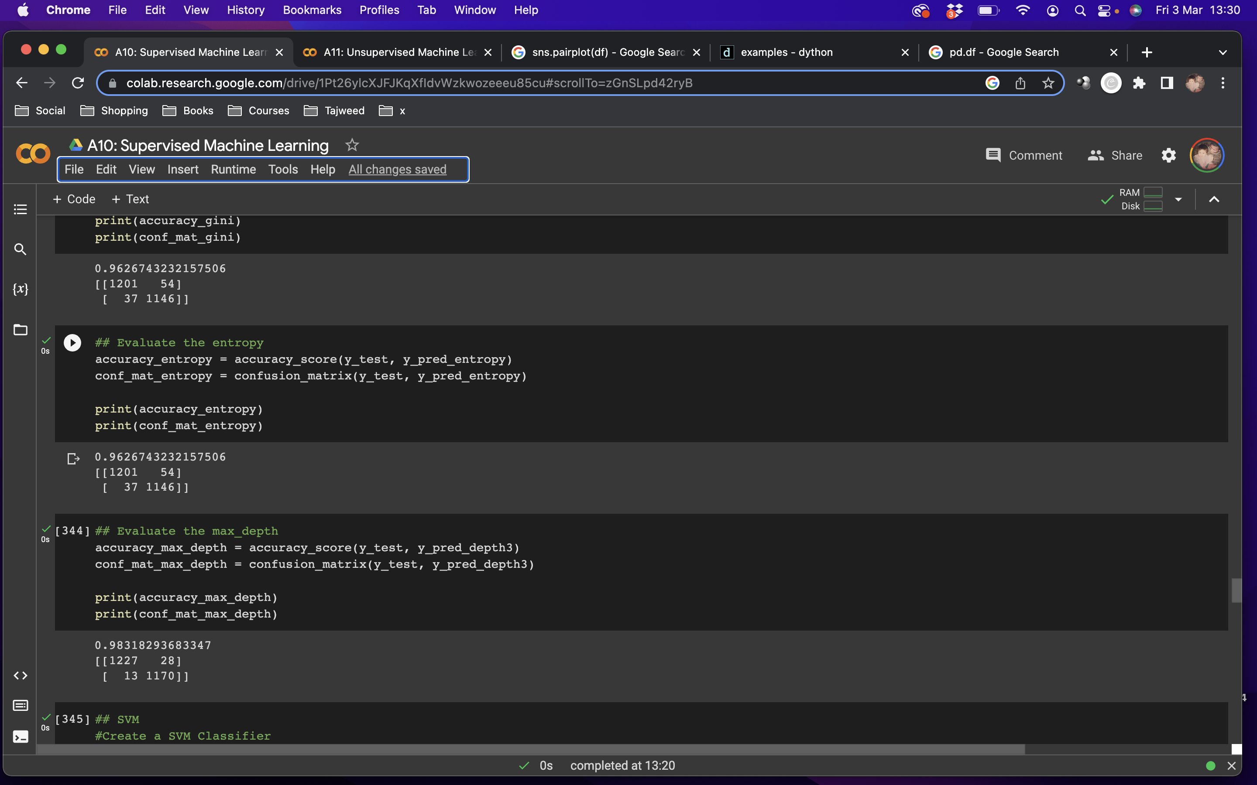
Decision Tree Classifier: Gini
Decision Tree Classifier: Entropy
Decision Tree Classifier: Depth3
Notes:
I also tried decision tree classifier that varied between 96 and 98% accuracy

Slide 15
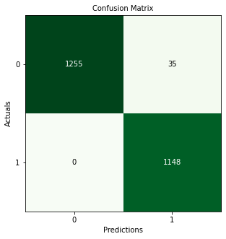
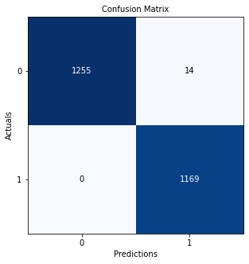
Decision Tree Classifier:
Odor and Class
Decision Tree Classifier:
Odor, Spore-Print-Color, Gill-Color and Class
98.5%
99.4%
TPR Model 1: 0.9728682170542635
TPR Model 2: 0.9889676910953507
Notes:
So then to compare, I also trained the model again with only the features that are most significant to to whether mushrooms are poisonous or not
Again, I used 70% training and 30% testing
With only the feature odor the decision tree classifier accuracy is high at 98.5% in model 1
Adding spore-print-color and gill-color gives an even higher accuracy of 99.4%
The 2 models are highly accurate, almost perfect with only 35 false negative predictions in model 1 and 14 false negative predictions in model 2
Both have 0 false positive results meaning there are no wrong predictions there

Slide 16
Conclusion
Notes:
In conclusion, using the 3 features that are most significant help us to predict if that the mushroom is poisonous or not more accurately than using just odor
But using all of them can give 99% as we saw in the KNN and even 100% with the Random Forest
I wanted to make a streamlit to test random entries, but I didn’t have the time. I expect that it would have given accurate results as most the models have shown an accuracy above 95%
The last and most important thing to remember is that if the mushroom has white spores, has a buff gill colour and smells foul, fishy or spicy then don’t eat it!
Thank you

Slide 17
Thank you!

